Slide 1
ECE314 Lab 13 Overview
Simple linear regression
Multiple linear regression

Slide 2
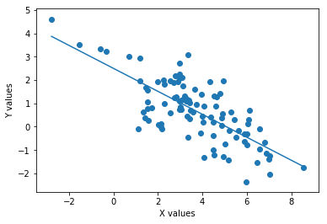


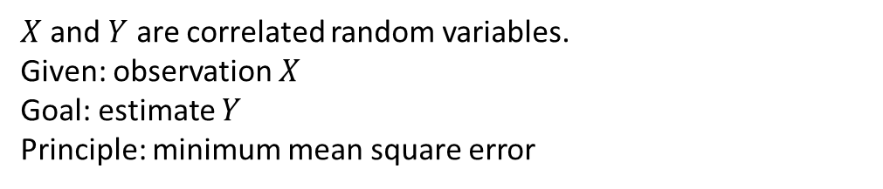
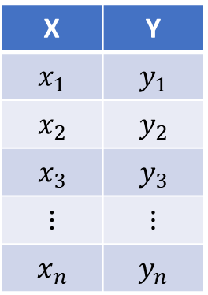

Simple Linear Regression
X | Y
$$x_{1}$$ | $$y_{1}$$
$$x_{2}$$ | $$y_{2}$$
$$x_{3}$$ | $$y_{3}$$
$$⋮$$ | $$⋮$$
$$x_{n}$$ | $$y_{n}$$
Exam 1 score
Final exam score
$X$ and $Y$ are correlated random variables.
Given: observation $X$
Goal: estimate $Y$
Principle: minimum mean square error
See ECE313 notes Section 4.9
MMSE estimator: $E[Y|X]$
MMSE linear estimator: $\hat{E}\left[Y | X\right]=L^{∗}(X)$, where
$$L^{∗}\left(u\right)=μ_{Y}+\frac{Cov\left(Y,X\right)}{Var\left(X\right)}(u−μ_{X})$$
$$=αu+β$$

Slide 3

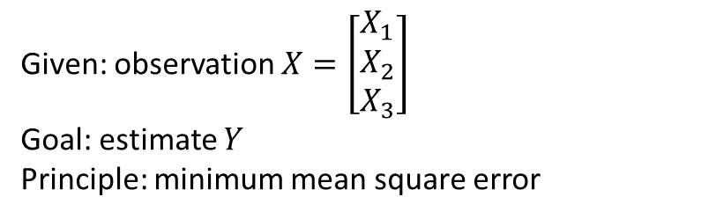
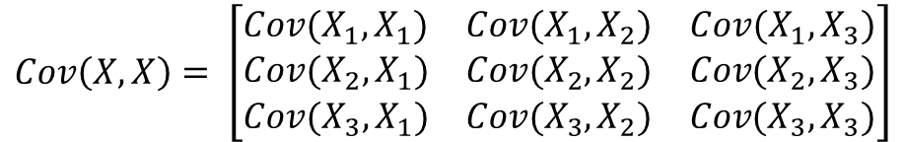
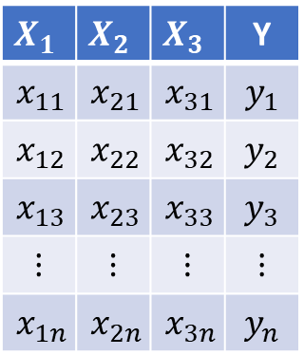
Multiple Linear Regression
$$X_{1}$$ | $$X_{2}$$ | $$X_{3}$$ | Y
$$x_{11}$$ | $$x_{21}$$ | $$x_{31}$$ | $$y_{1}$$
$$x_{12}$$ | $$x_{22}$$ | $$x_{32}$$ | $$y_{2}$$
$$x_{13}$$ | $$x_{23}$$ | $$x_{33}$$ | $$y_{3}$$
$$⋮$$ | $$⋮$$ | $$⋮$$ | $$⋮$$
$$x_{1n}$$ | $$x_{2n}$$ | $$x_{3n}$$ | $$y_{n}$$
Exam 1 score
Given: observation $X=\left[\begin{matrix}X_{1} \\ X_{2} \\ X_{3}\end{matrix}\right]$
Goal: estimate $Y$
Principle: minimum mean square error
Exam 2 score
Quiz score
MMSE linear estimator: $\hat{E}\left[Y | X\right]=E\left[Y\right]+Cov\left(Y,X\right) Cov{\left(X,X\right)}^{−1} (X−E[X])$
$$=α_{1}X_{1}+α_{2}X_{2}+α_{3}X_{3}+β$$
1x1
1x3
3x3
3x1
3x1
$$Cov\left(Y,X\right)= \left[Cov\left(Y, X_{1}\right) Cov\left(Y,X_{2}\right) Cov(Y,X_{3})\right]$$
$$Cov\left(X,X\right)= \left[\begin{matrix}Cov(X_{1}, X_{1}) & Cov(X_{1}, X_{2}) & Cov(X_{1}, X_{3}) \\ Cov(X_{2}, X_{1}) & Cov(X_{2}, X_{2}) & Cov(X_{2}, X_{3}) \\ Cov(X_{3}, X_{1}) & Cov(X_{3}, X_{2}) & Cov(X_{3}, X_{3})\end{matrix}\right]$$

